Slide 1
Design & Applications of Optimal Decision Making Models
最佳化決策模式設計與應用
Day 4
王 逸 琳 I-Lin Wang
ilinwang@mail.ncku.edu.tw
http://ilin.iim.ncku.edu.tw/
成功大學工業與資訊管理學系教授 2020/08/24-28 @成功校區 理學教學大樓(新大樓) 1樓36104室

Slide 2
Course Plans
Day 1: 2020/08/24 Quiz 1 [8%] (moodle or Zuvio)
Introduction (OR, applications, model/algorithm, complexity), Project Intro.
Software Installation & Demo (by TAs)
Day 2: 2020/08/25 Quiz 2 [8%], Project 1 due 08/29 11pm [15%]
Basics of Linear Programming & Integer Programming; LP modeling
Day 3: 2020/08/26 Quiz 3 [8%], Project 2 due 08/30 11pm [15%]
IP modeling techniques
Day 4: 2020/08/27 Quiz 4 [8%]
Applications: Facility Locations, Logistics Management, Routings (TSP)
Project Implementation help (by TAs)
Day 5: 2020/08/28 Quiz 5 [8%]
Applications: Routings (RPP), Scheduling (RCPSP)
Project Implementation help (by TAs)
Day 6: 2020/08/29 1-hr on-line Exam (moodle) [20%]

Slide 3
Applications
Project Management
PERT diagram, critical path
Resource constrained project scheduling problem (RCPSP)
Scheduling
Parallel machine scheduling
Routing (Part I)
Min-cost flow problem : shortest path, maximum flow
Constrained shortest path
Evacuation

Slide 4
The Time to Complete a Project-1
To make the customer receive the adv by July 2, when should we start the whole process? Is June 2 ok?
!! Nonpreemptive (i.e., cannot be interrupted)!!
 | Task | Day
A | Choose items from stock by dept manager | 3
B | Choose items to be brought in by buyers | 2
C | Choose & price items for adv by committee | 2
D | Prepare picture for sale item | 4
E | Prepare description for sale item | 3
F | Design adv | 2
G | Compile mailing list to send adv | 3
H | Print mailing labels | 1
I | Print adv | 5
J | Attach labels, stored adv by zip code | 2
K | Deliver adv | 10
Preceding Tasks
None
None
A,B
C
C
D,E
C
G
F
H,I
J
D
A
4
F
3
E
2
I
C
5
K
2
3
B
10
2
G
H
J
3
1
2
Notes:
Buyer: 採買

Slide 5
The Time to Complete a Project-2
D
D
A3
4
A3
4
C=>max{3,2}+2
F
F
3
E
2
I
3
E
2
I
C
5
K
C5
5
K
2
3
2
3
B2
10
B2
10
2
G
H
J
2
G
H
J
3
1
2
3
1
2
D9
D9
4
4
F=>max{9,8}+2
A3
F
A3
F11
3
E8
2
I
3
E8
2
I
C5
5
K
C5
5
K
2
3
2
3
B2
10
B2
10
2
G8
H
J
2
G8
H9
J
3
1
2
3
1
2
D9
D9
A3
4
J=>max{9,16}+2
A3
4
F11
F11
3
E8
2
I16
3
E8
2
I16
C5
5
K
C5
5
K28
2
3
2
3
B2
10
B2
10
2
G8
H9
J18
2
G8
H9
J18
3
1
2
3
1
2
Notes:
Task Time Length Preceding Tasks
A Choose items by dept manager 3 days None
B Choose items by buyers 2 None
C Choose & price items for ads 2 A,B
D Prepare picture for sale item 4 C
E Prepare word for sale item 3 C
F Design adv 2 D,E
G Compile mailing list 3 C
H Print mailing labels 1 G
I Print adv 5 F
J Attach labels, stored by zip code 2 H,I
K Deliver adv 10 J

Slide 6
Critical Path Analysis
At least need 28 days ➔ June 2 is ok
Graph Properties:
Appearance is not unique
Acylic
PERT: Program Evaluation and Review Technique (1958 US Navy Polaris submarine and missile project)
Hang up the destination node, the longest path == critical path
D9
A3
4
F11
3
E8
2
I16
C5
5
K28
2
3
B2
10
2
G8
H9
J18
3
1
2

Slide 7
IP formulation for Critical Path
Given
A set of n tasks J={1,2,…,n}, where task i requires p_{i} time and ri amount of resource
What to determine?
When to do which task i ?
Objective : to complete the project asap
➔ Decision Variable
➔ To min makespan

Slide 8
RCPSP example

Slide 9
RCPSP formulation (1/2)
Set
I : task
R : resource
Indices
i,j
r
Cannot be used since
I(t) depends on the relationship between s_{i} and t

Slide 10
RCPSP formulation (2/2)

Slide 11
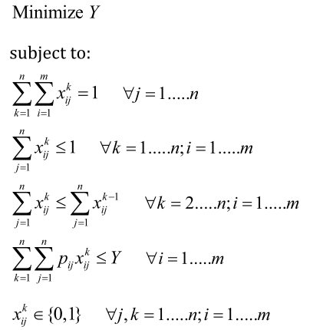
Parallel Machine Scheduling
n jobs (j) on m machines (i)
position: ordering of a job on a machine
p_{ij} : processing time of job j on machine i
Y : makespan, the latest time to complete all the jobs

Slide 12
Q & A
Thanks!
I-Lin Wang (王逸琳)
Professor
Dept of Industrial & Information Management
National Cheng Kung University http://ilin.iim.ncku.edu.tw/

